Slide 1
Live Air Quality Monitoring App Using IOT
Submitted in the partial fulfillment for the award of the degree of
BACHELOR OF ENGINEERING
IN
COMPUTER SCIENCE ENGINEERING (AIML)
Submitted by:
Abhishek.M: 21BCS6748
Md.Shabeer: 21BCS6001
Under the Supervision of:
Ravneet Kaur
Department of AIT-CSE
DISCOVER . LEARN . EMPOWER

Slide 2
Outline
Introduction to Project
Problem Formulation
Objectives of the work
Methodology used
Conclusion
Future Scope
References

Slide 3
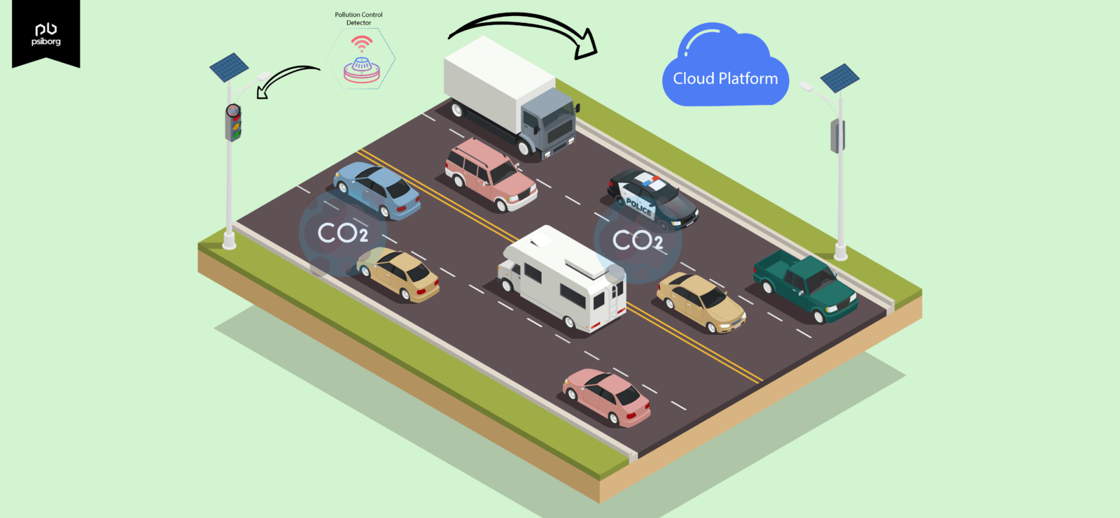
Introduction to Project
Air quality is a critical aspect of our daily lives, with direct implications for both human health and the environment. The quality of the air we breathe is influenced by various factors, including pollutants, temperature, humidity, and atmospheric conditions. In many regions, air pollution has reached alarming levels, posing significant health risks and environmental challenges.

Slide 4
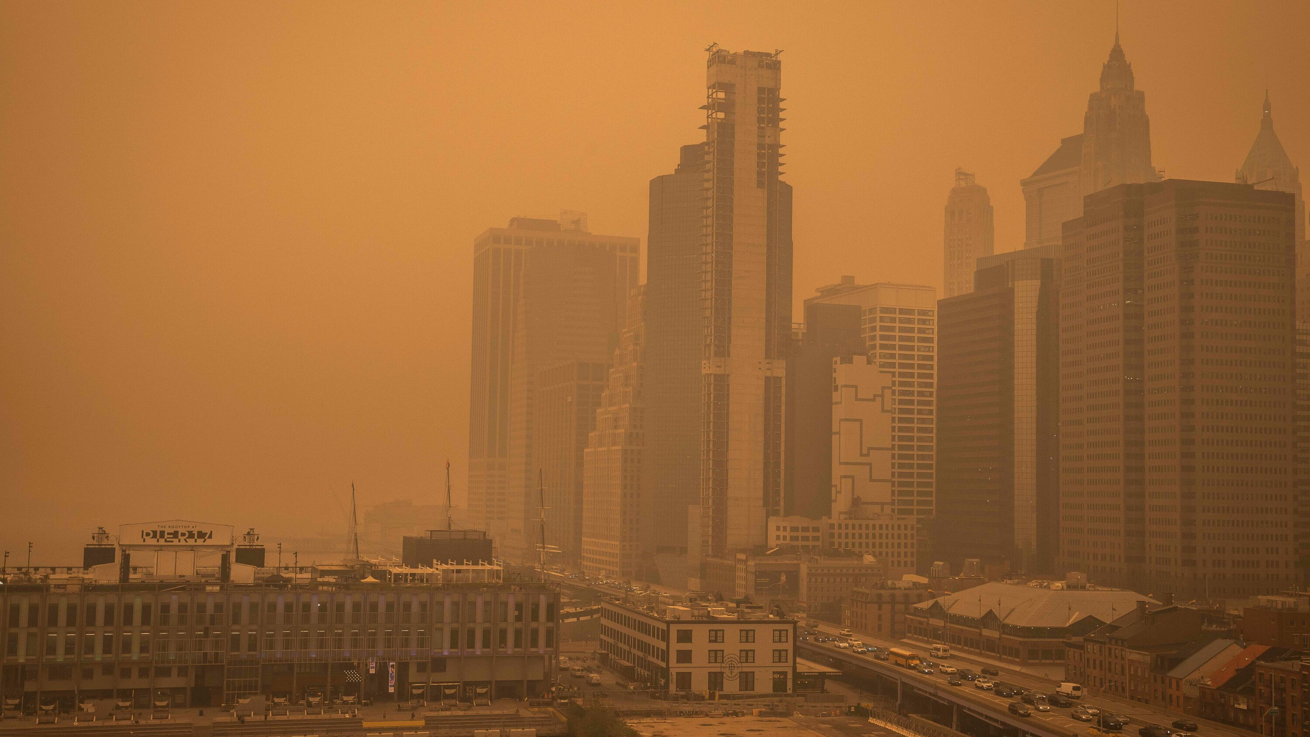

Problem Formulation
Air pollution is a critical environmental concern affecting the health and well-being of individuals and communities worldwide. The existing air quality monitoring systems often lack accessibility, real-time data, and user-friendliness, which hinders people's ability to make informed decisions regarding their exposure to air pollutants. Therefore, there is a pressing need to address these limitations by developing a Live Air Quality Monitoring App using IoT, DHT11, and Flutter.

Slide 5

The specific problem areas include:
Inadequate Real-time Data.
Lack of User-Friendly Platforms.
Limited Accessibility.
Hardware and Software Integration Challenges.

Slide 6
Objectives of the Work
To develop a hardware setup using DHT11 sensors to measure temperature and humidity.
To Implement an IoT infrastructure for data transmission from sensors to a central server.
To create a Flutter mobile application for users to access real-time air quality data.
To calculate the Air Quality Index (AQI) based on sensor data.
To provide notifications and alerts to users based on predefined air quality thresholds.

Slide 7
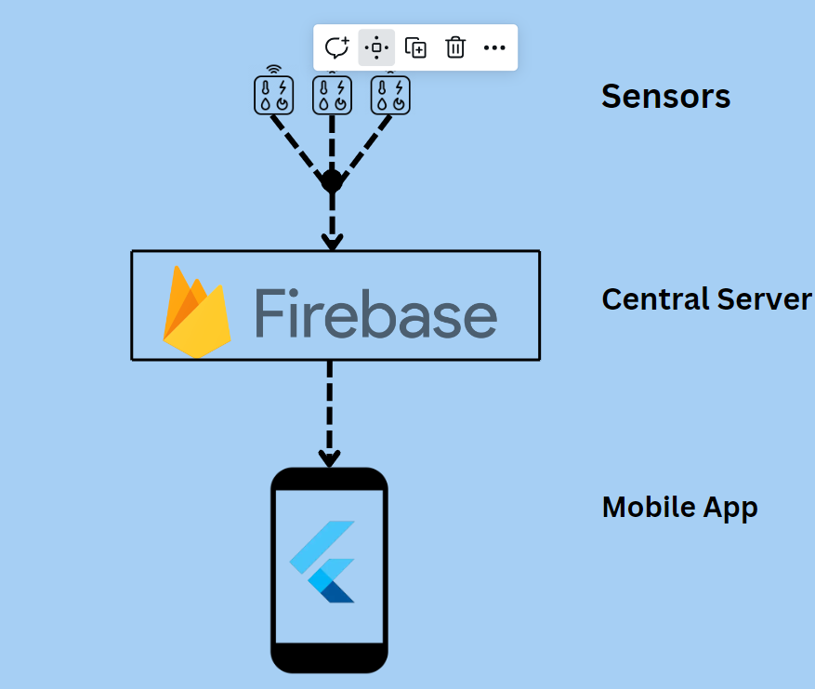
Methodology used
Retrieve Data from sensor.
Store Data to the server.
Pull Data from the server to App.
Display the Data in App.

Slide 8
Conclusion
This project aims to provide an accessible and user-friendly solution for real-time air quality monitoring using IoT technology. It will empower users to make informed decisions about their environment's air quality and safety.
In conclusion, the "Live Air Quality Monitoring App" represents a significant step towards improving air quality awareness and public health. By leveraging IoT technology, sensor integration, and a user-friendly app, this project has the potential to make a substantial positive impact on individuals and communities. As we continue to innovate and expand our efforts, we aim to contribute to a healthier and more informed world.

Slide 9
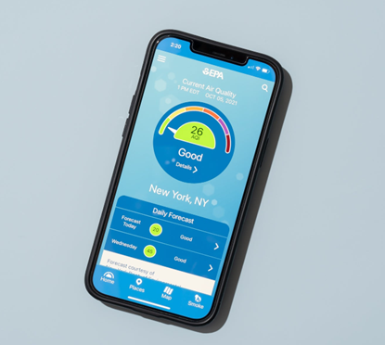
Future Scope
Creating a live air quality monitoring app using IoT (Internet of Things) has a promising future scope due to its potential benefits in addressing environmental concerns and public health. As technology continues to advance, here are some potential future developments and trends for such an app:
Advanced Sensor Integration.
Real-Time Data and Alerts.
Data Analytics and AI.
Integration with Smart Devices.
Community Engagement.
Global Coverage.
Personalized Recommendations.
Environmental Education.

Slide 10
References
[1] Smith, J., & Johnson, E. (2022). IoT-Based Air Quality Monitoring System for Urban Environments. International Journal of Environmental Science and Technology.
[2] Rajasekaran, A., & Sundaram, S. (2017). An Internet of Things (IoT) based air pollution monitoring system.
[3] Gupta, A., et al. (2017). Air quality index (AQI) based performance analysis of an IoT system for environmental monitoring.
[4] Shreya Mahetaliya1, Dipansh Makwana1, Anchal Pujara1, Prof. Sandeep Hanumante. IoT based Air Quality Index Monitoring using ESP32.

